Slide 1


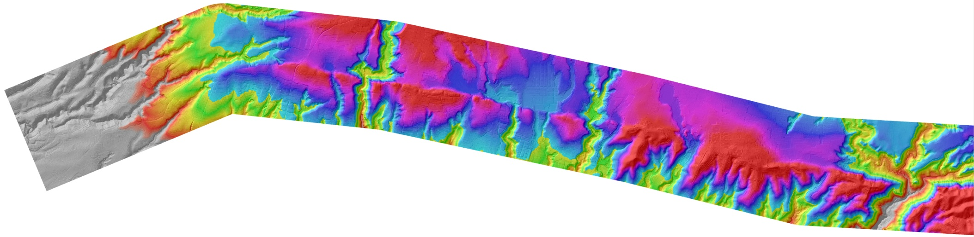




Pelatihan :
Techniques in Active Tectonic Study
Juni 20-Juli 2, 2013
Instruktur: Prof. J Ramon Arrowsmith (JRA)
Dari Arizona State University (ASU) - US
Tempat Pelaksanaan:
Ruang Pangea, Laboratorium Gempabumi (LabEarth) – Puslit Geoteknologi LIPI dan Kuliah lapangan akan dilakukan disekitar Sesar Lembang, Jawa Barat.
* Lebih jelas baca TOR/KAK dan daftar acara

Slide 2
Topographic metrics and bedrock channels
Outline of this lecture
Topographic metrics
Fluvial scaling and slope-area relationships
Channel steepness sensitivity to rock uplift

Slide 3
Topographic Metrics
Many Topographic metrics have been proposed. We’ll examine the three most common
  Channel Steepness Index
  Hillslope Gradients
  Local Relief at Various Scales
What are the relationships among these?
Which are most useful for gaging the influence of tectonics on topography?
--K. X Whipple

Slide 4
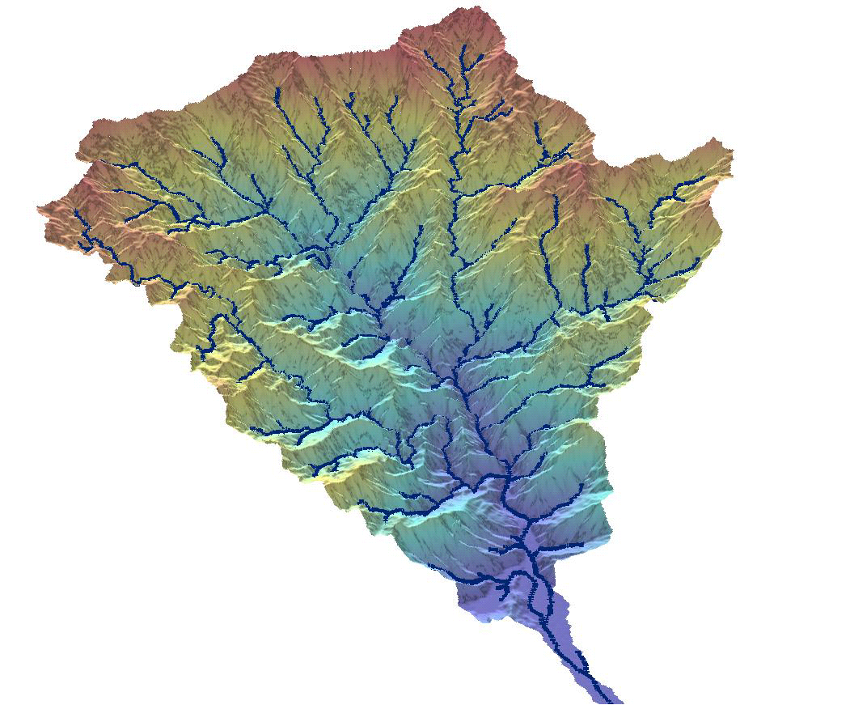
80-90% Relief is on Bedrock Channels
Blue lines: drainage area > 1km²
--K. X Whipple

Slide 5
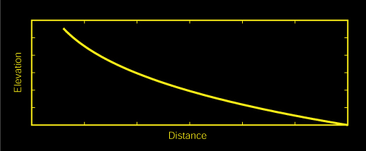
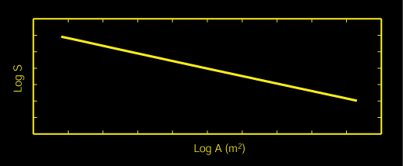
Fluvial Scaling – Empirical Data
Empirical data for well-adjusted fluvial systems around the globe yield the following scaling:
S = k_{s}A^{-θ}
Linear relationship between log(S) and log(A)
k_{s} is the channel steepness; θ is the concavity
--K. X Whipple

Slide 6
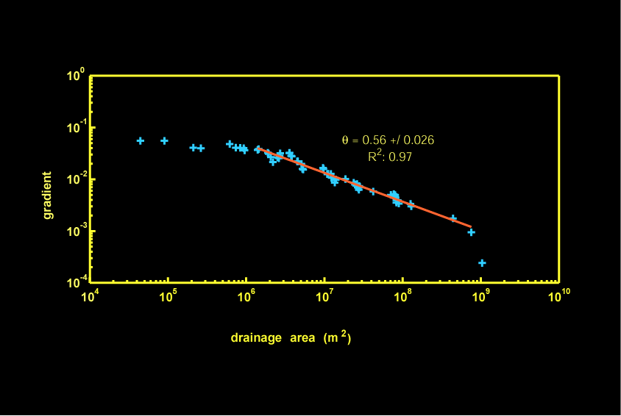
Flint’s Law: Mixed Bedrock-Alluvial Stream (Appalachians, VA)
--K. X Whipple

Slide 7
Flint’s Law: Mixed Bedrock-Alluvial Stream (Appalachians, VA)
S = k_{s}A^{-θ}
colluvial
reach
-θ
k_{s}
k_{s} is a more general morphometric index:
No dependence on basin shape
--K. X Whipple

Slide 8
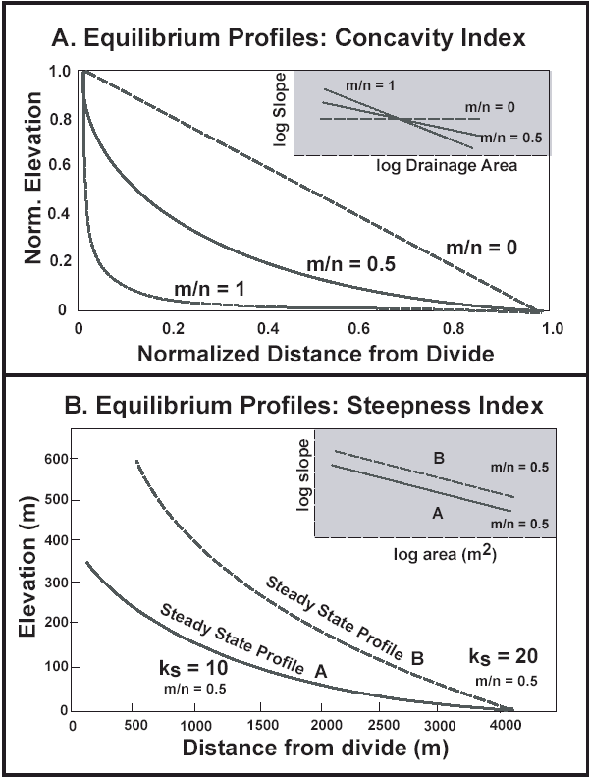
Duvall, Kirby, and Burbank, 2004, JGR-ES
U = Rock Uplift Rate
Concavity (θ) invariant with U
θ = m/n
S = k_{s}A^{-θ}
Steepness (Ks) varies with U
k_{s}
--K. X Whipple

Slide 9
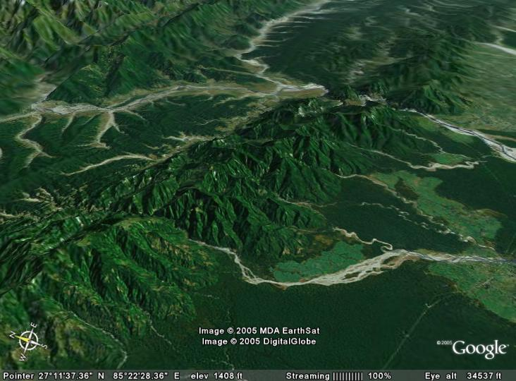
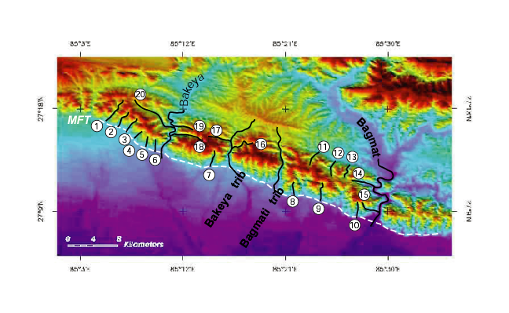
Siwalik Hills, Nepal
--K. X Whipple

Slide 10
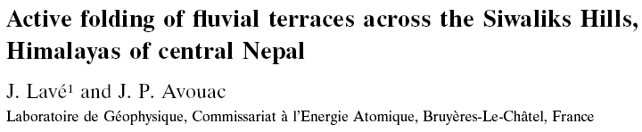
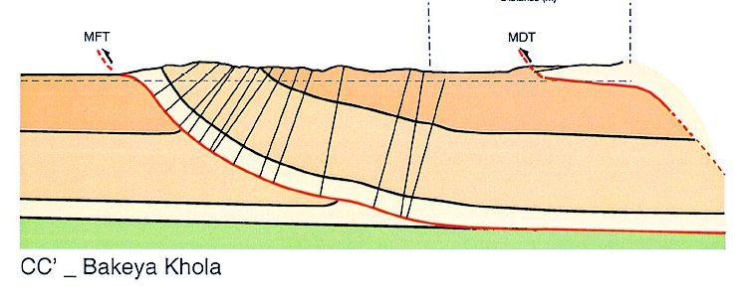
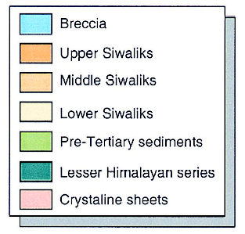
--K. X Whipple

Slide 11
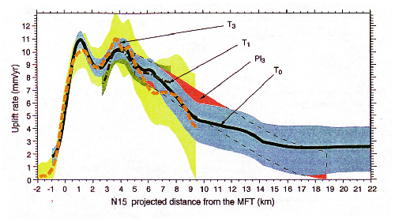
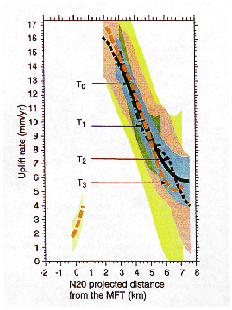
Bagmati Transect
Bakeya Transect
Data from Lave and Avouac, 2000, JGR
--K. X Whipple

Slide 12
Siwalik Hills Anticline
Himalaya Foreland, Nepal
--K. X Whipple
Strike-Parallel: Uniform Uplift Along Stream

Slide 13
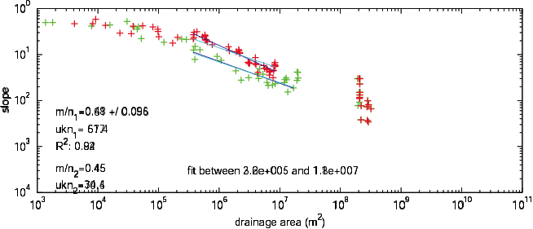
Strike-Parallel: Normal, uniform concavity
14 mm/yr
7 mm/yr
Strike-Parallel: Steepness varies with U
--K. X Whipple

Slide 14
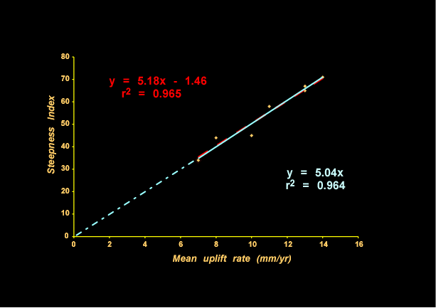
Siwalik Hills, Nepal
Steepness (Ks) varies with U
--K. X Whipple

Slide 15
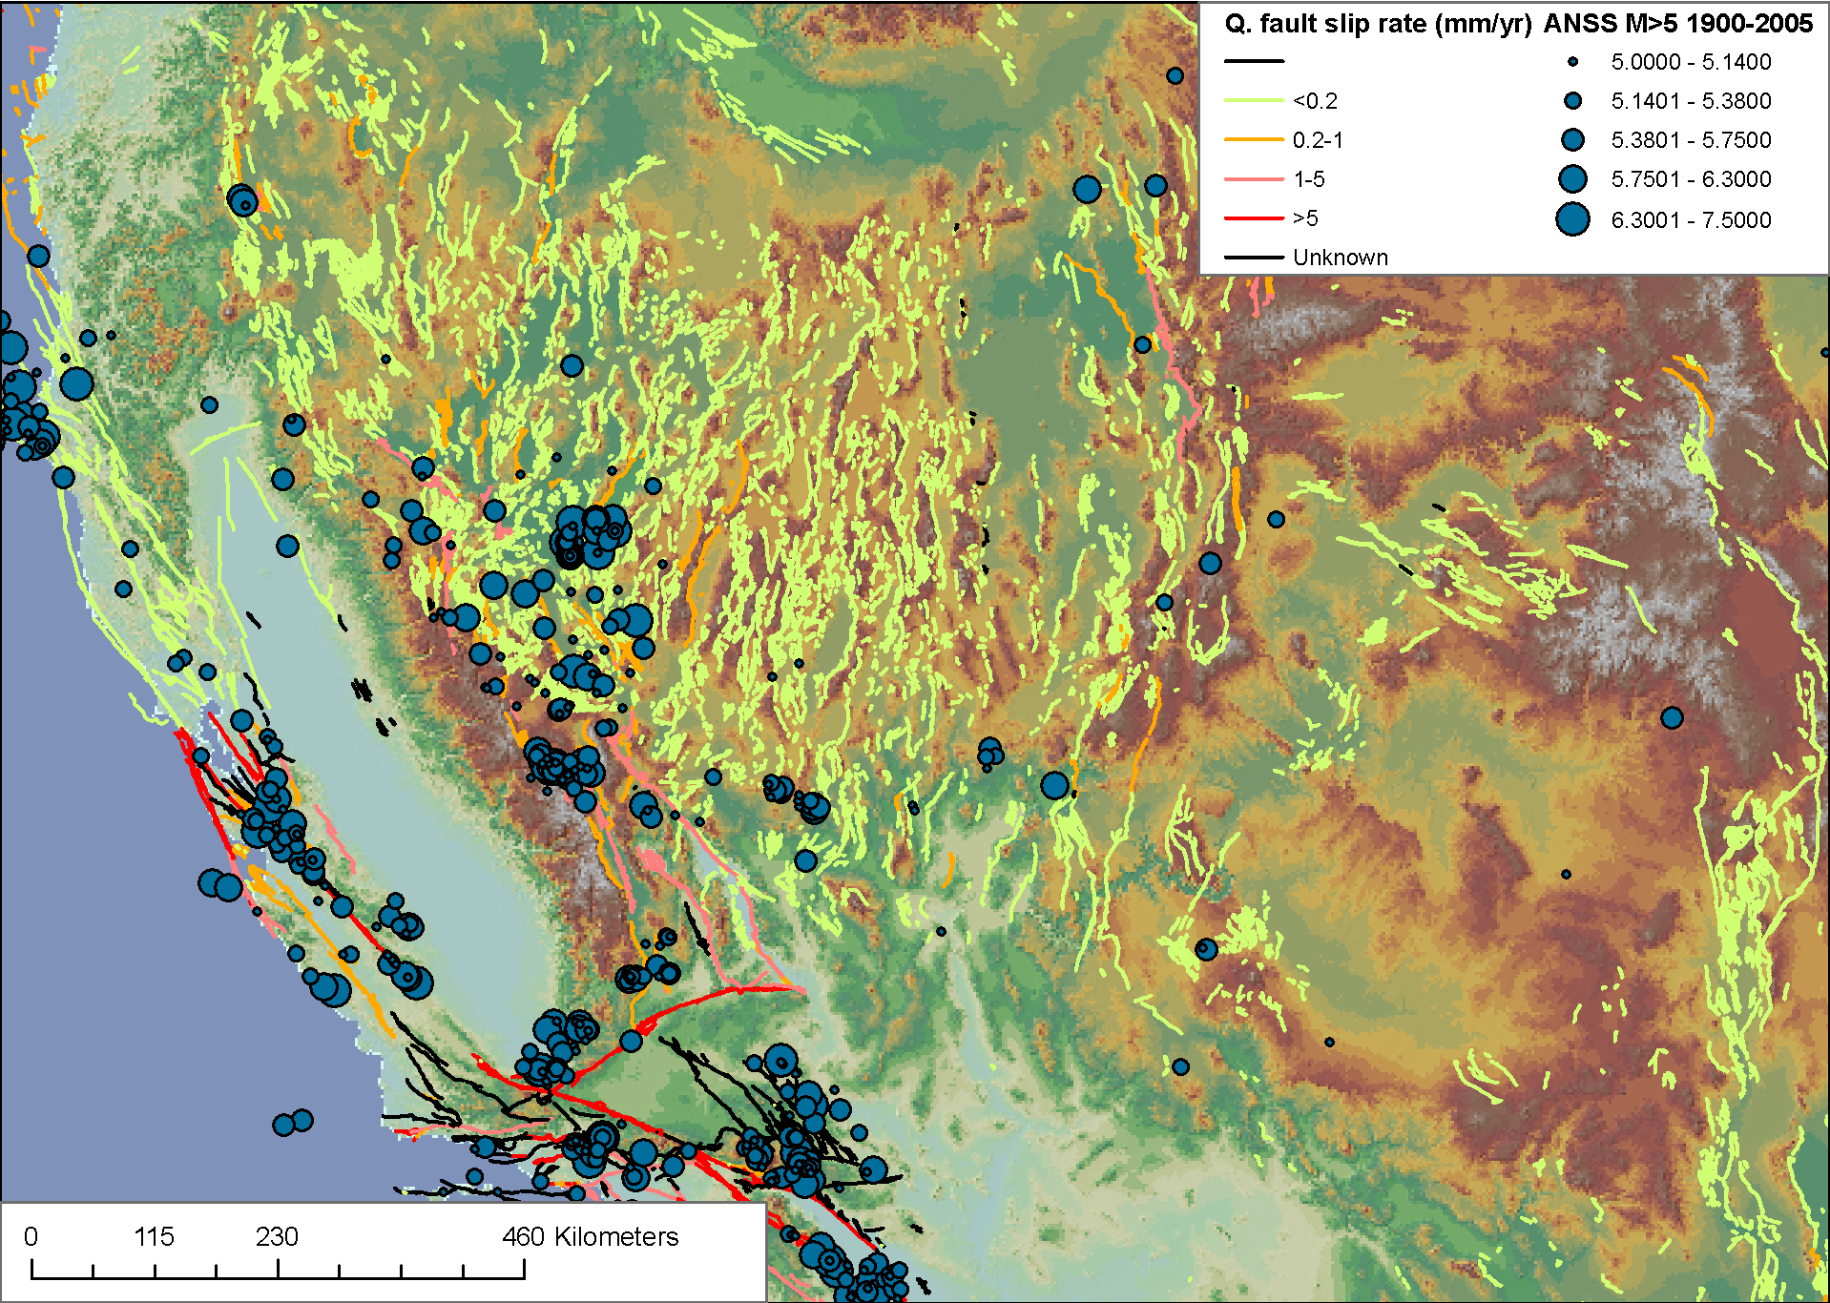
Tectonic Geomorphology of the San Gabriel Mountains
http://qfaults.cr.usgs.gov
http://earthquake.usgs.gov/anss/

Slide 16
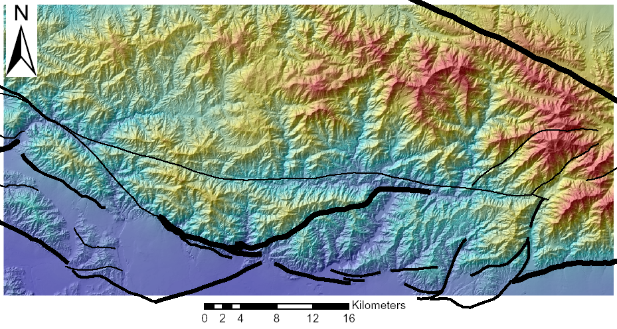
Shaded Relief with Color = Elevation
Active Faults
Thickness = Most Recent Known Slip
--K. X Whipple

Slide 17
Beware: Many authors use “hillslope relief” and “local relief” (measured over up to 5km radius) as interchangeable
--K. X Whipple

Slide 18
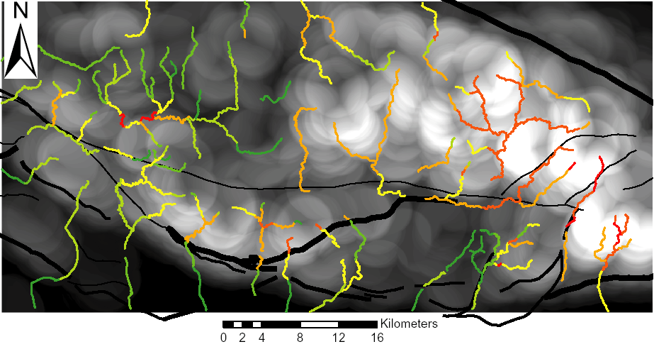
Streams by Normalized Steepness Index
Local Relief (r = 2.5km)
Note: abrupt steepness breaks across active faults, no break where inactive/slow
--K. X Whipple

Slide 19
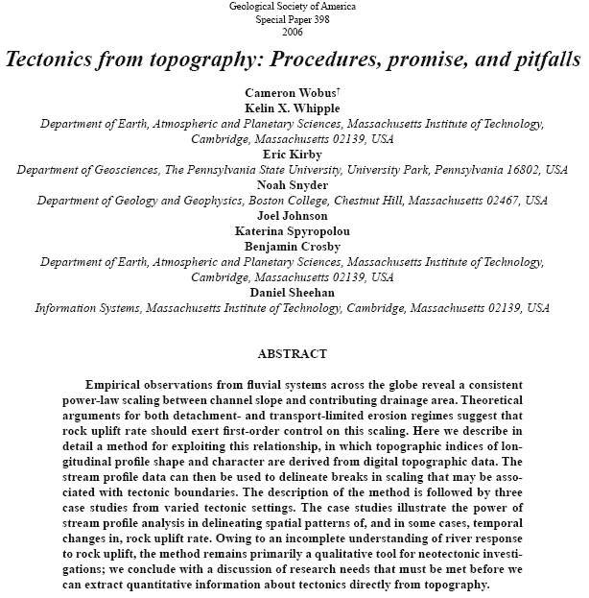

Slide 20
Topographic metrics and bedrock channels
Outline of this lecture
Topographic metrics
Fluvial scaling and slope-area relationships
Channel steepness sensitivity to rock uplift

