Slide 1
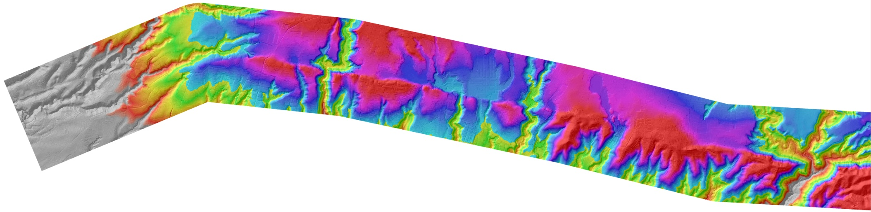
Pelatihan :
Techniques in Active Tectonic Study
Juni 20-Juli 2, 2013
Instruktur: Prof. J Ramon Arrowsmith (JRA)
Dari Arizona State University (ASU) - US
Tempat Pelaksanaan:
Ruang Pangea, Laboratorium Gempabumi (LabEarth) – Puslit Geoteknologi LIPI dan Kuliah lapangan akan dilakukan disekitar Sesar Lembang, Jawa Barat.
* Lebih jelas baca TOR/KAK dan daftar acara

Slide 2
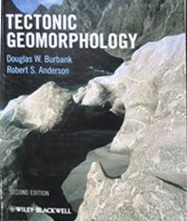
Cosmogenic radionuclide geochronology Outline of this lecture
Overview of method and applications
Surface dating for slip rate
Profile dating for terrace age
Burial dating for erosion rate
Many figures from this textbook

Slide 3
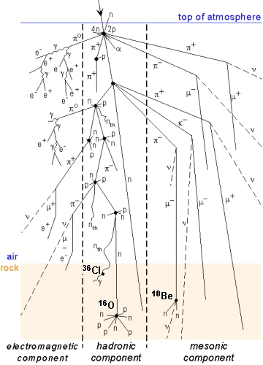
High energy charged particles enter the Earth’s atmosphere and interact with it and the Earth surface to produce cosmogenic nuclides
Modulated by solar activity, earth’ geomagnetic field, geography
Main nuclides include:
¹⁴₇N, ¹⁰₅Be, ²⁶₁₃Al, ³⁶₁₇Cl,
³⁹₁₈Ar , ³He, ²¹Ne
http://www.geo.arizona.edu/palynology/geos462/11datingmeth.html
Important reference:
http://cnef.earthsciences.dal.ca/NewFiles/cnefTCN-Method.html

Slide 4
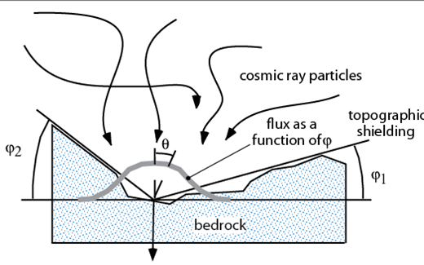
Burbank and Anderson, 2011, Tectonic Geomorphology, Chapter 3

Slide 5
P₀ is production at the surface
Z* is e-efolding depth (decrease by 1/e: ~2.7)
Z is really total number of atoms
dN/dt =P₀ –λN
N is number of atoms per unit volume
t is time
λ is radioactive decay
Burbank and Anderson, 2011, Tectonic Geomorphology, Chapter 3

Slide 6
Target minerals
(Schaefer and Lifton, 2007)
Stable noble gases- Measure oldest surfaces in tens of million years
³He Olivine, Pyroxene, Fe/Ti-Oxide Minerals, Garnet
²¹Ne Quartz, Olivine, Pyroxene, Sanidine
³⁸Ar Calcium, (experimental)
Radiogenic- Order decreasing half lives
¹⁰Be Quartz, Calcite, Sanidine
²⁶Al Quartz
³⁶Cl Whole Rock, Feldspar
¹⁴C Olivine
In Situ ¹⁴C Quartz, Olivine

Slide 7
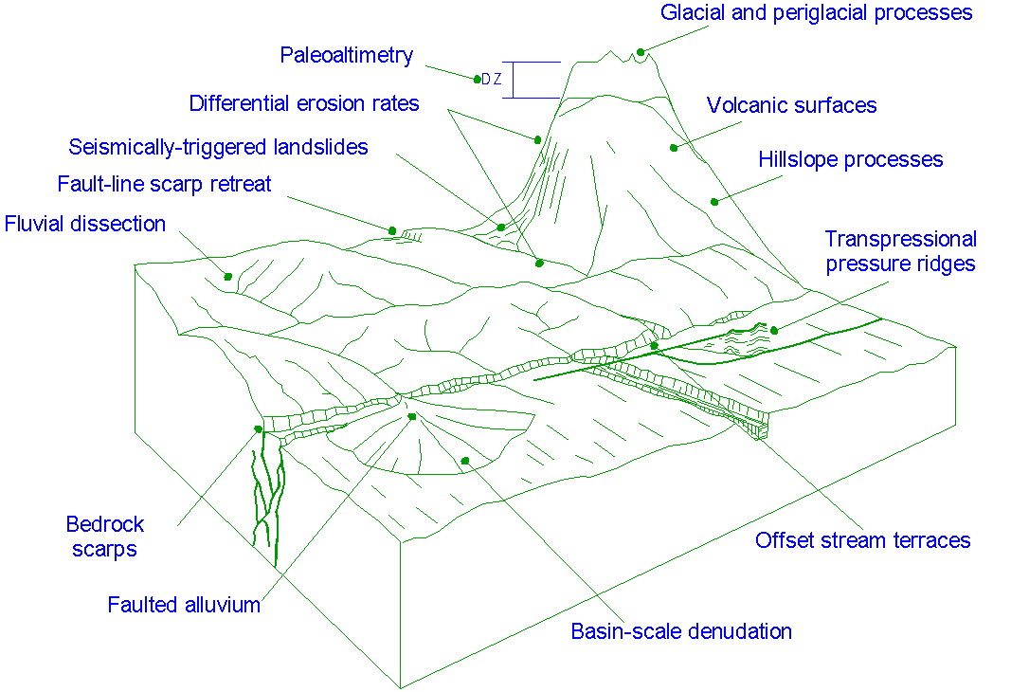
http://cnef.earthsciences.dal.ca/NewFiles/cnefTCN-Method.html

Slide 8
Deformation rate variation and the role of faulting
Data too noisy?
Measuring different things? (age, offset, aperture)
Missing earthquakes?
Deformation zone evolution
Lower crust and upper mantle
High rates over long time and localized deformation important: continental deformation more plate-like
Lower rates over long time and broad space: continental deformation more fluid-like
Friedrich, et al., 2003

Slide 9
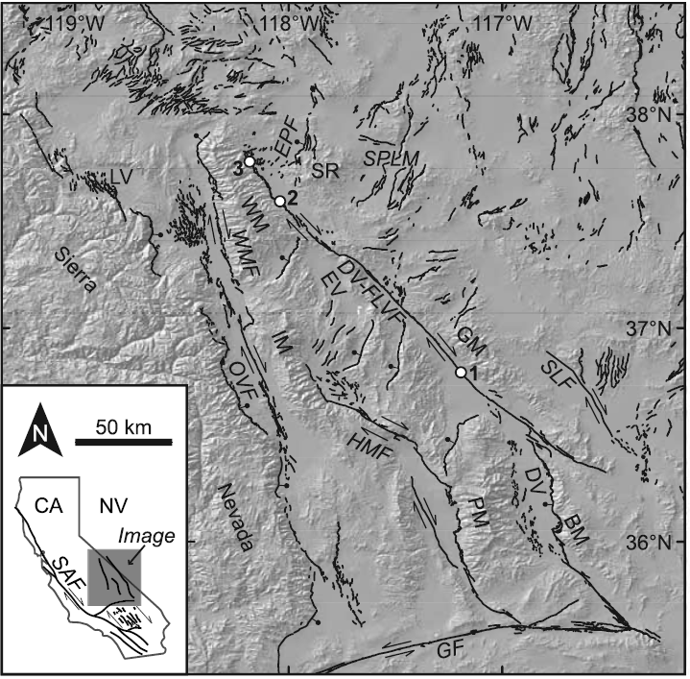
Dating surface boulder samples

Slide 10
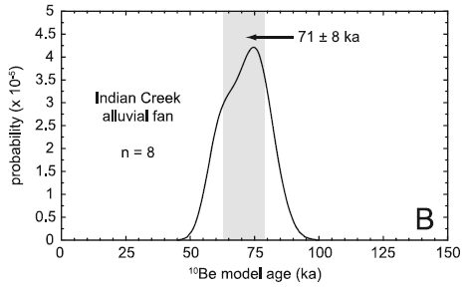
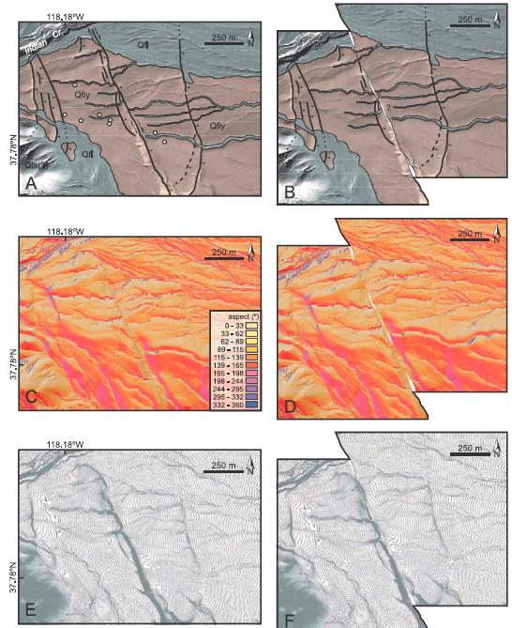
178 ± 20 m retrodeformation
2.5 ± 0.4 mm/yr

Slide 11
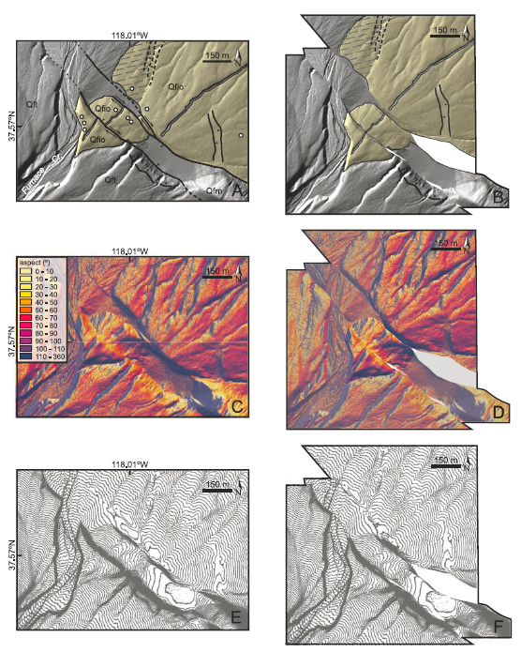
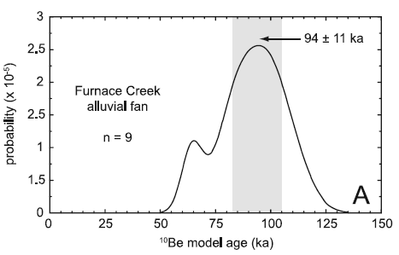
290 ± 20 m retrodeformation
3.1 ± 0.4 mm/yr slip rate

Slide 12
Dating marine terraces: Santa Cruz, California

Slide 13
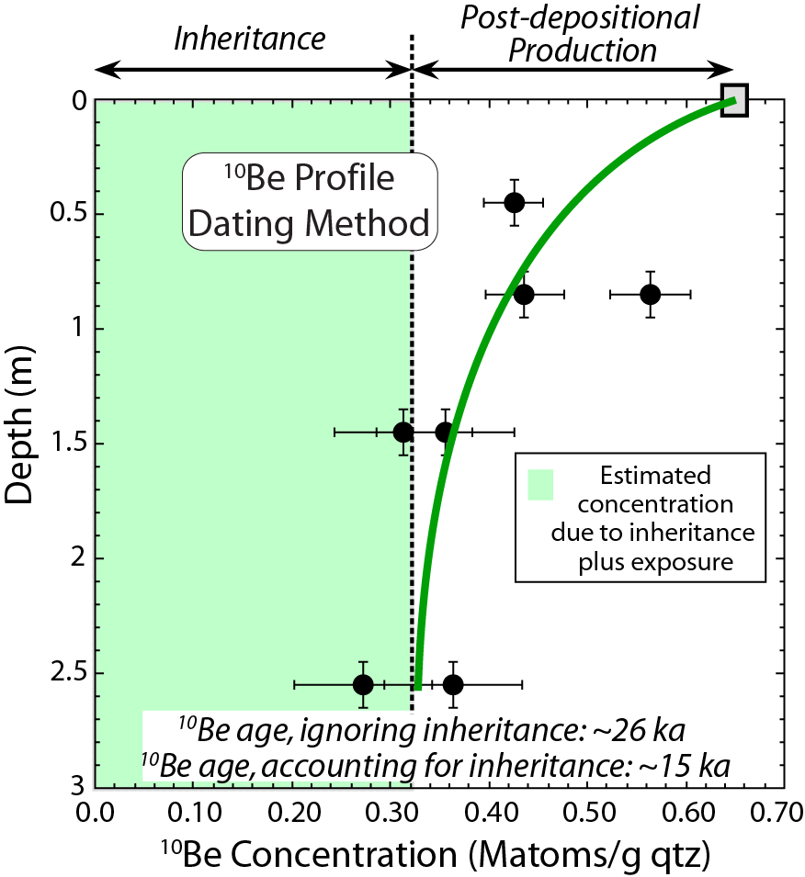
Erosion rate in the watershed influences the inheritance
Burbank and Anderson, 2011, Tectonic Geomorphology, Chapter 3

Slide 14
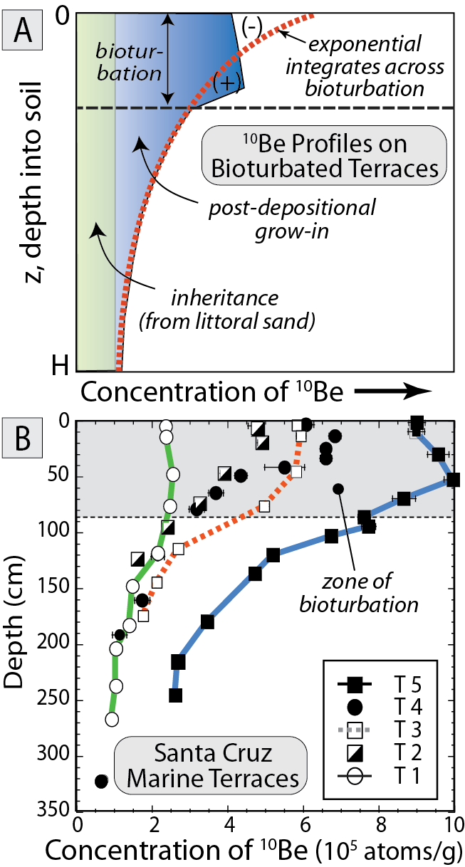
Burbank and Anderson, 2011, Tectonic Geomorphology, Chapter 3

Slide 15
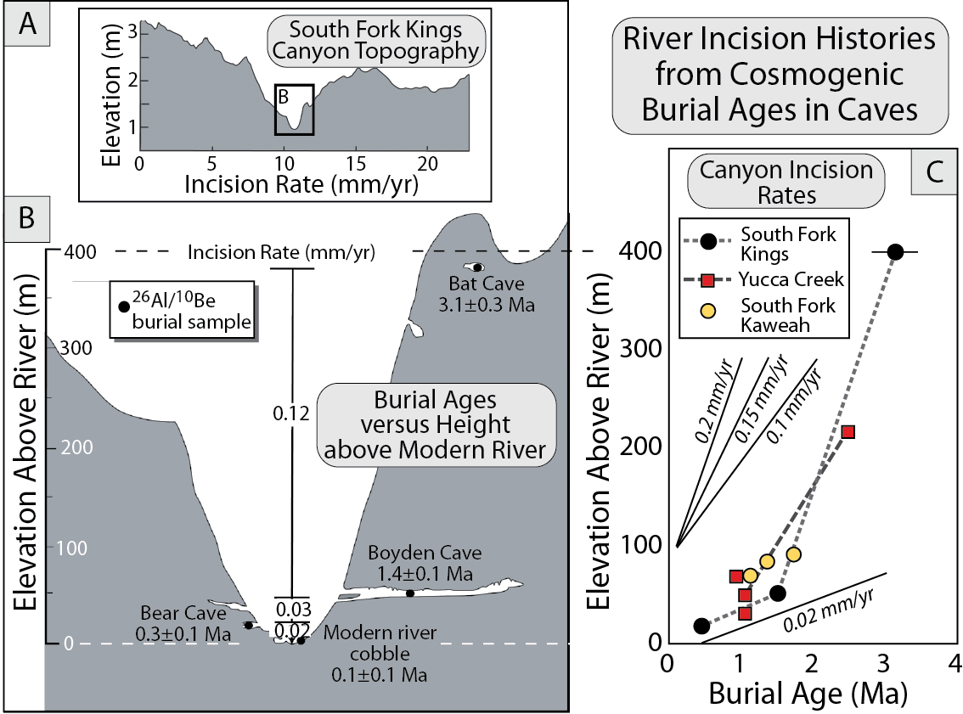
Burbank and Anderson, 2011, Tectonic Geomorphology, Chapter 3

Slide 16
Cosmogenic radionuclide geochronology Outline of this lecture
Overview of method and applications
Surface dating for slip rate
Profile dating for terrace age
Burial dating for erosion rate
Many figures from this textbook

