Slide 1

Homework 2, Reverse faulting
GLG494/598 (ASU) and GEOL 701J (UNR): Mapping tectonic faults from geomorphology
Chelsea Scott
cpscott1@asu.edu

Slide 2
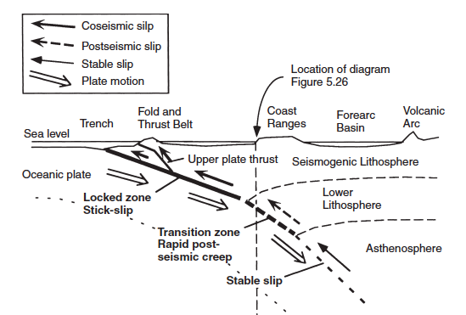
Cascadia Subduction Zone
Convergence rate: 4 cm/yr
Last megathrust earthquake: 1700
Crustal earthquake in the forearc
Seattle fault: M7 earthquake 900-930 CE
Juan de Fuca Plate
North America Plate

Slide 3
Lidar- Light detection and ranging
Sensitive to vegetation and bare earth
Digital Surface Model: DSM
Digital Terrain Model: DTM

Slide 4
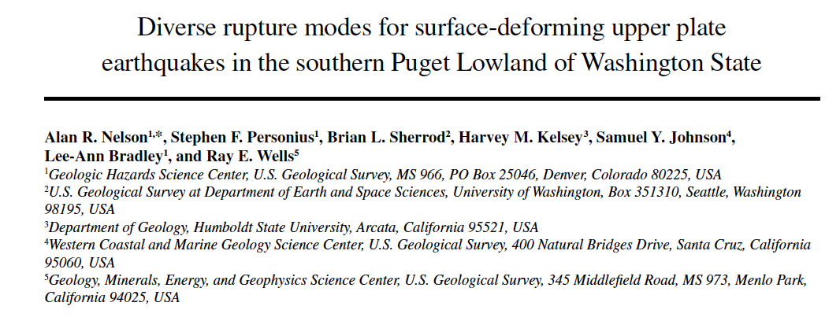

Slide 5
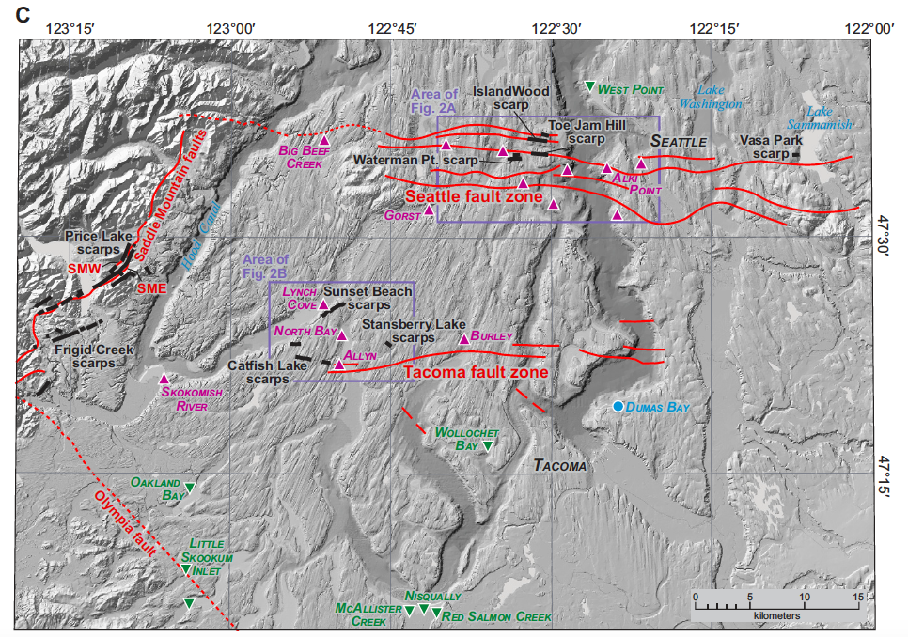

Slide 6
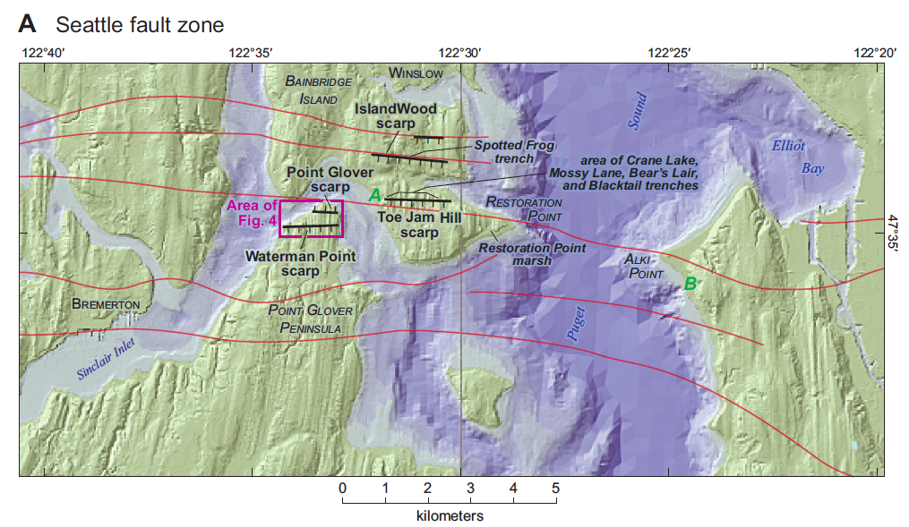

Slide 7
