Slide 1
Principal
Source: University of California Fault Displacement Hazard Initiative Project
Main or principal through-going fault at depth that breaks the ground surface.
Principal ruptures can manifest on the ground surface in complicated ways, including: simple, curvilinear traces; segmented en echelon, anastomizing, branching, or moletrack zones; overlapping step-overs; flower or other slip-partitioning structures; or monoclinal warping
Distributed
Not the main fault; antithetic, spatially distributed, discontinuous

Slide 2
Curvilinear fault
En echelon
Branching
Tri-furcated branching
Anastomizing

Slide 3
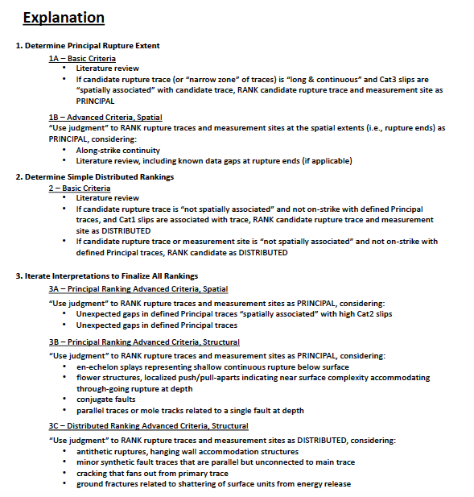
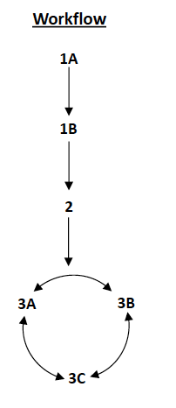
Determining if principal vs. distributed
Depends on fault properties, datasets, geologist’s interpretations-> important to justify your reasoning

