Slide 1
Intro to exercise: Mapping landforms with applications to geomorphology and earthquake geology
Mapping tectonic faults from geomorphology
Ramón Arrowsmith
ramon.arrowsmith@asu.edu

Slide 2
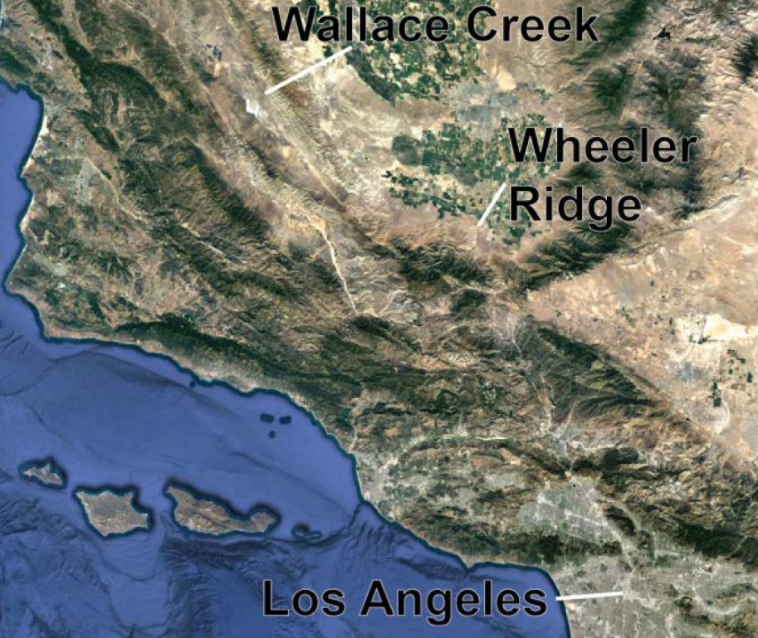
Exercise on simple mapping for landforms along active faults
Designed as in class exercise; pencil and paper ok if you can print it out and then take pictures of the result to turn in. Or, use a drawing program.
This exercise is just for the Wallace Creek site

Slide 3
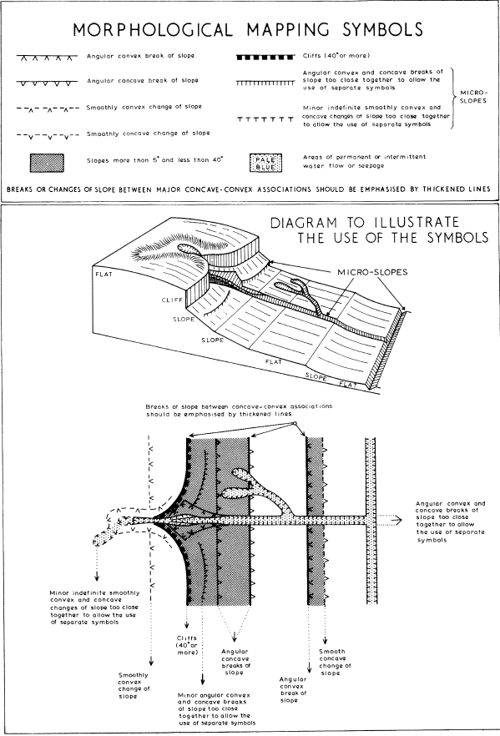
A simple language of morphology
Each element is a letter that we use to build up the words of the landforms
-Savigear, 1965

Slide 4
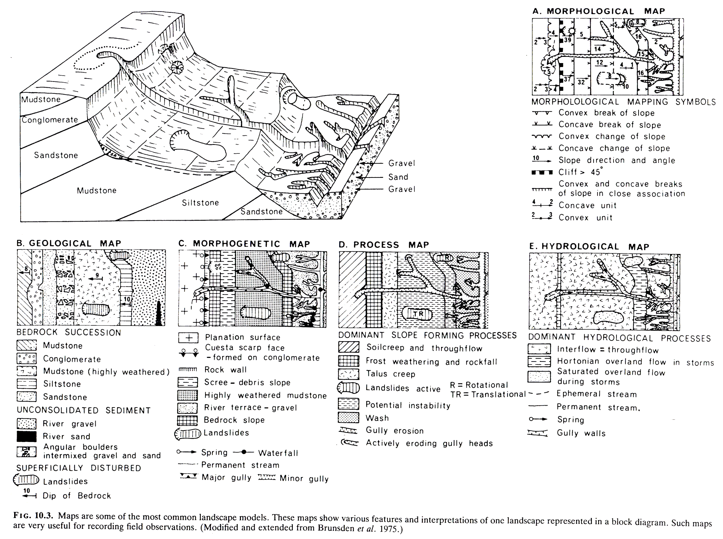
What kind of mapping?
builds from: A Technique of Morphological Mapping R. A. G. Savigear Annals of the Association of American Geographers Vol. 55, No. 3 (Sep., 1965), pp. 514-538

Slide 5
Mapping the San Andreas Fault (SAF) near Wallace Creek California
Goals--After completing this exercise, you should have these basic skills:
Create hillshades, slope shades, and contour maps for an area using QGIS.
Use aerial/satellite photography, topographic maps, and other topographic data to delineate landforms.
Identify tectonic landforms along a strike-slip fault system

Slide 6
Mapping the San Andreas Fault (SAF) near Wallace Creek California
Tasks:
Load basemaps in QGIS
Imagery
DEM
Slopeshade + hillshades
Contour map
Make a morphologic and geomorphic map of the site
Identify major tectonic landforms along strike slip faults
Progressive interpretation

Slide 7
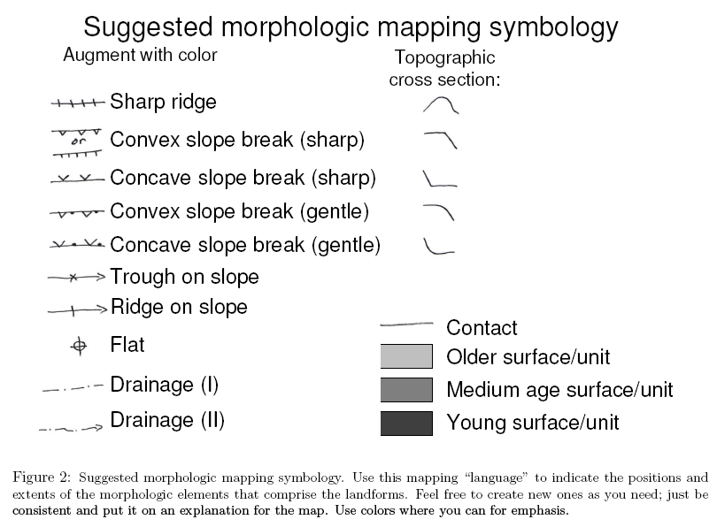
Feel free to modify! Just include an explanation

Slide 8
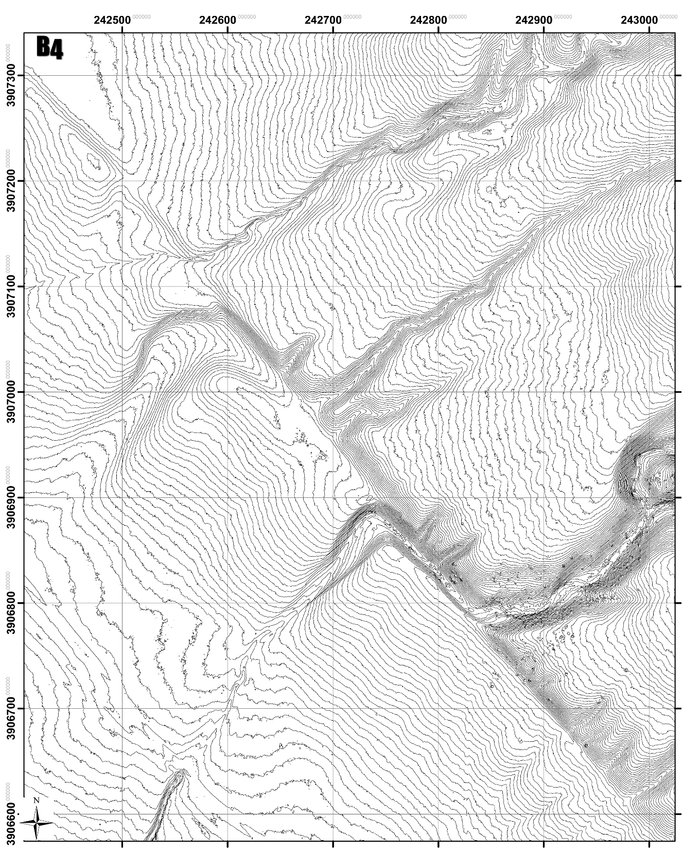
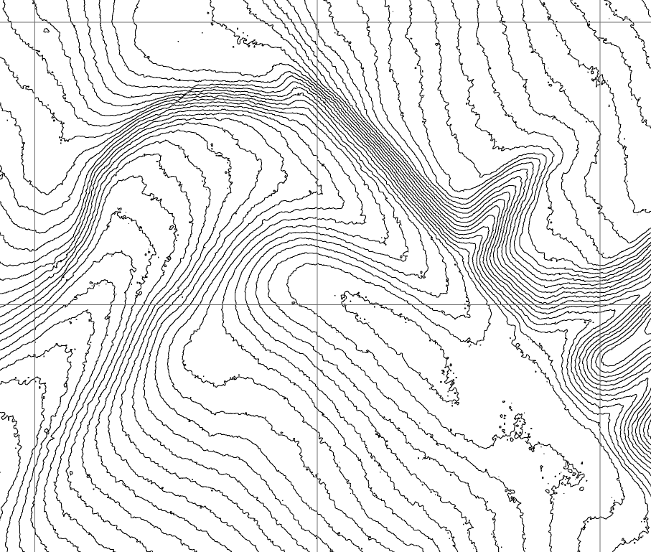

Slide 9
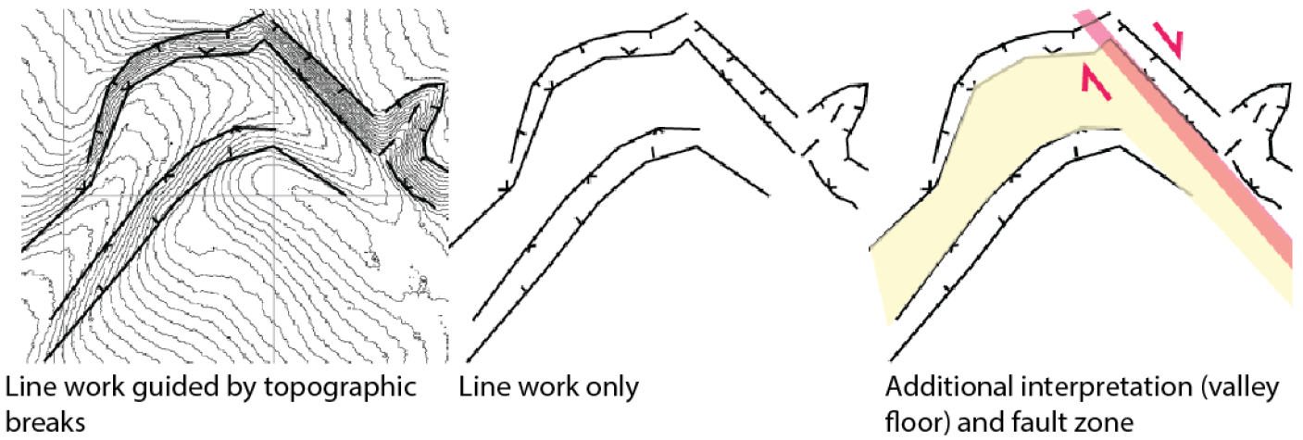

Slide 10
Example of a completed part from up in the NW:

Slide 11
https://www.vectorstock.com/royalty-free-vector/scissors-cartoon-vector-21843654

